Slide 1

Red Hat Ansible Platform technical deck
Creating, operating, and consuming automation
Shadd Gallegos
Shadd@redhat.com
Associate Principal Specialist Solution Architect
Notes:
During this presentation we will briefly cover our approach to automation and why Ansible Automation Platform, then dive into the value of this platform as it applies to your business context.

Slide 2

Red Hat Ansible Platform technical deck
Anyone can automate...
but an enterprise needs to coordinate and scale
Notes:
I would like to start with our philosophy on enterprise automation. Anybody can automate something - be it a script, a standalone playbook, etc. Enterprises, however, need more than just simple automation - Enterprises need coordination, and to scale, and to coordinate at scale.

Slide 3







Many organizations share the same challenge
Red Hat Ansible Platform technical deck
Too many unintegrated, domain-specific tools
Network ops
SecOps
Devs/DevOps
IT ops
Notes:
There is an added challenge: in many IT teams it is common to have multiple domain- specific tools. Networking has its own tools. So does infrastructure. And security. These tools are rarely integrated with each other; and additionally, these teams are often isolated from other teams, meaning integration across the teams themselves is often limited if it exists at all.
The challenges don’t stop there: the people inside one team have different motivations, and different bases of knowledge. If you bring multiple teams together, perspectives can clash. A person who fills a persona in one team can fill a different persona in another team, such as an expert developer needing to consume some networking resources, or a security operations remediation workflow being managed by an IT operations specialist.

Slide 4




Break down silos
Red Hat Ansible Platform technical deck
Different teams a single platform
Consistent governance
Cloud
Edge
Datacenter
Line of business
Devs/DevOps
IT ops
SecOps
Network ops
Notes:
IT automation can bring the necessary change to tackle these challenges by...
integrating the different tools within siloed domains
streamlining processes across the tools
breaking down the silos between teams, integrating the various tools and processes across teams
establishing consistent governance of processes, products, and technologies
offering clear interfaces to provide and to consume resources as part of the automation
providing clear means to implement new processes and new content to extend the automation it self

Slide 5
Why the Red Hat® Ansible® Automation Platform?
Red Hat Ansible Platform technical deck
Notes:
Is there a single turnkey solution? No. While the components and problems found in each IT department are often similar, the actual combination of challenges together with the actual products and tools in use are often unique. And the situation is developing and thus changing over time!
That means: there is not a single turnkey solution that solves everything once and for all.
For that reason, the solution can only be a platform: a platform that can be used to build a solution tailored to individual needs - and to grow for future development.
The platform we have to solve this is the Ansible Automation Platform.

Slide 6



Why the Ansible Automation Platform?
Why the Red Hat Ansible Automation Platform?
Powerful
Simple
Agentless
Orchestrate complex processes at enterprise scale.
Simplify automation creation and management across multiple domains.
Easily integrate with
hybrid environments.
Notes:
So what is the Ansible Automation Platform, if not Ansible itself? The characteristics that make Ansible so popular are not only applied but extended by the Automation Platform.
The POWER of a single universal language across multiple technology domains.
The AGENTLESS model that allows seamless integration with a variety of technology platforms.
The SIMPLE nature of the Ansible Language to enable a broad selection of users to become functional in a short space of time.
And the platform enables an enterprise to operate and manage with Ansible at the scale, complexity and flexibility required by the modern enterprise.

Slide 7









Automate the deployment and management of automation
Why the Red Hat Ansible Automation Platform?
Your entire IT footprint
Do this...
Orchestrate
Manage configurations
Deploy applications
Provision / Deprovision
Deliver continuously
Secure and comply
On these...
Firewalls
Load balancers
Applications
Containers
Virtualization platforms
Servers
Clouds
Storage
Network devices
And more ...
Notes:
What does that mean in tangible detail? What can you really do with the Ansible Automation Platform?
A lot, and across multiple domains:
Orchestrate fleets of VMs across the open hybrid cloud
Manage the configuration of networking devices across data centers
Enable application deployment to integrate load balancer changes and CMDB configuration
Enable developers to provision their own storage objects in an automated fashion when needed
Embed the automated configuration of external services into the CI/CD pipeline
Integrate firewalls with intrusion detection systems into streamlined security remediation workflows
Manage the lifecycle of existing applications and infrastructure, updating applications and hardware in streamlined processes

Slide 8



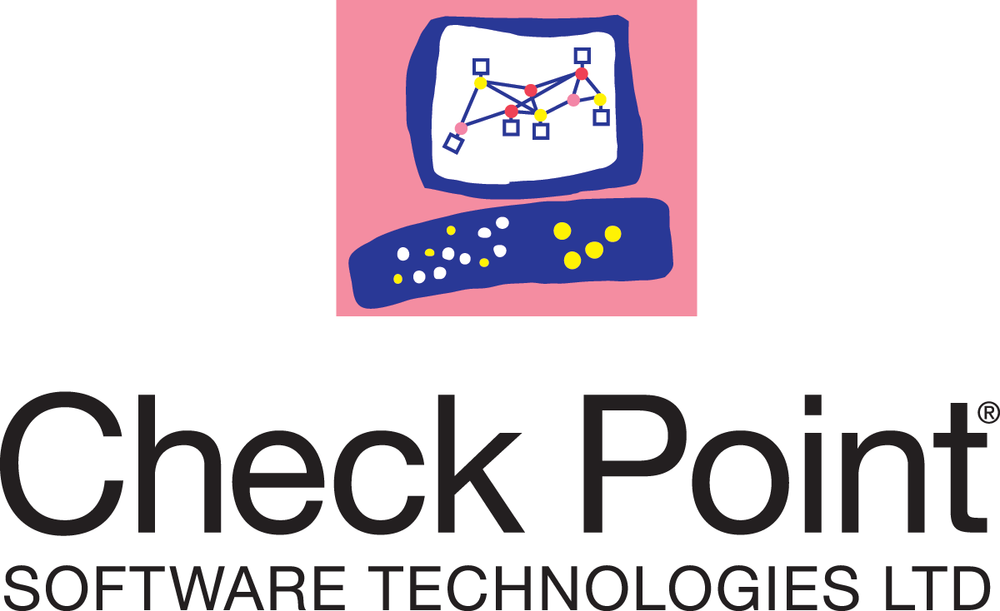
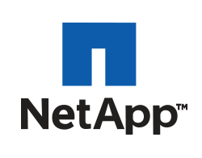

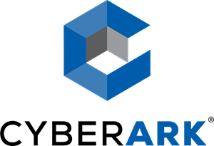





Why the Red Hat Ansible Automation Platform?
90+
Infrastructure
Cloud
Network
Security
certified platforms
Notes:
There are more than 90 Certified Content Collections, supporting over 30 technology partners and covering multiple different use cases.
What matters with automation is what IT organizations are aiming to accomplish, and Ansible’s Content Domain initiatives are designed to support real-world use cases across all the different pieces of an enterprise IT stack to help customers becoming productive faster and with a better return of investment. As part of the content domain we define use cases in the content domain, and get partners on board to provide certified content collections supporting the use cases in the content domains. We also communicate the use cases across partners, customers and community and provide enablement in form of focused documentation.
The Certified Content program provides co-support for partner developed modules making the Ansible Automation Platform the first automation platform on the market enabling end-to-end supported automation.

Slide 9
What makes a platform?
Red Hat Ansible Platform technical deck
Notes:
So - what does this platform consists of? And how do the components work with each other?

Slide 10
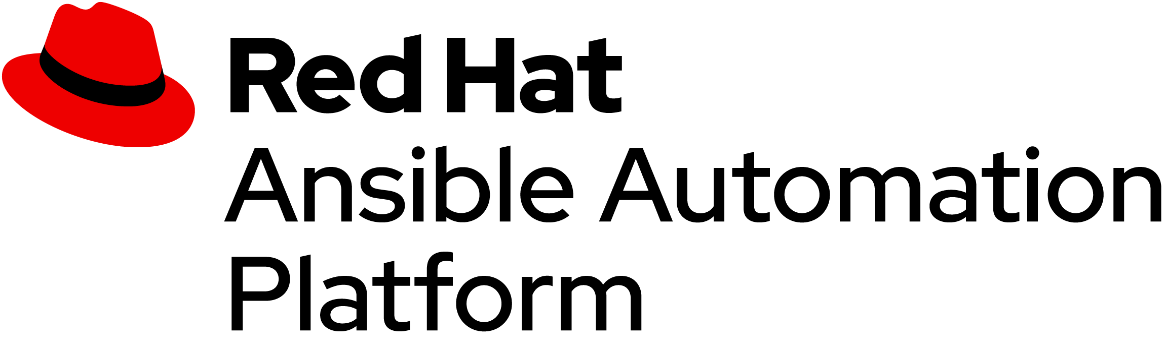

What makes a platform?
Ansible automation
Providing scalable, secure implementation for describing, building, and managing the deployment of enterprise IT applications across diverse enterprise architectures.
Combining the universal automation language with cloud services and certified content for automating, deploying, and operating applications, infrastructure and services securely at enterprise scale.
Cloud services
Cloud services that facilitate team collaboration and provide operational analytics for automating heterogeneous, hybrid environments.
Certified content
Extends native platform capabilities with certified, supported content designed to expand the automation domain and accelerate adoption for enterprise customers.
Notes:
The platform consists of multiple components. This enables us to build an automation solution tailored to our needs - to solve the problems we face.
A core part most likely already known to many are the parts that make the Ansible Automation architecture. But this is extended by cloud services which are tied closely to it. And automation would be nothing without integrations, without the content expanding the automation to the products and domains out there.
Value: they can use the components they need, and build solutions they require. And when their challenges change, they can adapt their solution with the components flexibly.
Example: If their IT grows by another team, and more collaboration is needed, they can integrate more tightly with the cloud services.
Ending question: Who would be using Ansible? And how does it look like to them?

Slide 11
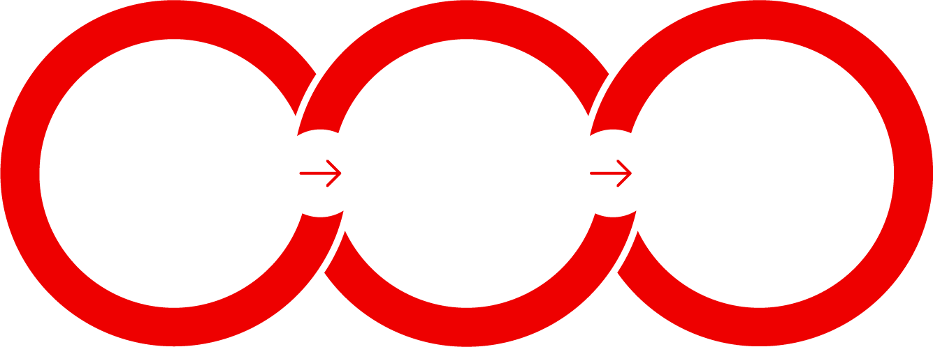


What makes a platform?
Holistic automation for your enterprise
Create ▸
Operate ▸
Consume ▸
Notes:
There are three areas in which the platform is used, and those areas are tied to certain kinds of users, personas.
The creators:
engineers
subject matter experts
domain experts
playbook writers
The operators:
automation administrators
network admins
cloud admins
firewall operators
The consumers:
non-automators using turnkey automation
automators, but from other IT domains, just consuming automation which is not native to them
Ending question: These were the personas, so what does the technology stack look like?

Slide 12


What makes a platform?
On-premises
Ansible Cloud Services
Content creators
Automation controller
Automation
hub
Automation
services catalog
Insights for Ansible Automation Platform
Operators
Ansible content domains
Infrastructure
Cloud
Network
Security
Linux
Windows
Domain experts
Ansible command line
Users
Fueled by an open source community
Notes:
The architecture of the platform consists of a several core components, shown on the right, which are used by mentioned personas related to automation, indicated on the left.
Let’s have a closer look at the different parts, what they are made of, how they work with each other, from the perspective of the personas.

Slide 13

Red Hat Ansible Platform technical deck
Create
Notes:
The “create” part of the platform is all about the content generation. To write the actual automation code which in the end will move the bits and pieces.

Slide 14
Red Hat Ansible Platform technical deck: Create
Create
The automation lifecycle
Ansible content experience
Build
Content creators
Red Hat cloud / on-premises
Discover
Automation hub
Ansible content domains
Trust
Infrastructure
Cloud
Network
Security
Domain experts
Linux
Windows
Notes:
At the core of each automation is the language itself - in which the content of the automation is written in. So we start with what the Ansible Automation language looks like, how it can be written - created - and how content written in the language is managed.
As part of this, we take the perspective of the people in charge of this: the domain experts who know all about the systems in question to be automated. They need to write - and maintain - code to automate the systems. And they have a need to store and maintain the code throughout the entire life cycle, aiding them in the development.
value: Companies writing their own automation scripts (bash, powershell, etc) have a huge, ever growing cost of maintenance for those, including an ever growing risk of problems and flaws. With a standardized language and integrations, maintenance cost comes down, and growth becomes manageable again.
example: in configuring Cisco switches: instead of customized bash scripts which are hard to read and harder to maintain and update, there are standardized, short playbooks leveraging the Cisco-written integration which can be read and understood by people not that familiar with Cisco. Or Bash.
Ending question: Let’s see what this actually looks like, what all the components mentioned here are and how they relate to each other.

Slide 15

Red Hat Ansible Platform technical deck: Create
Ansible playbooks
---
- name: install and start apache
hosts: web
become: yes
tasks:
- name: httpd package is present
yum:
name: httpd
state: latest
- name: latest index.html file is present
template:
src: files/index.html
dest: /var/www/html/
- name: httpd is started
service:
name: httpd
state: started
Notes:
Let’s start with a playbook example. As you can see it is rather short, and consists of three “tasks”; this playbook does three things.
The language itself is simple to grasp, and since each task carries a “name” statement, everything is already partially documented.
Value: Quick to learn, low entry barrier, and no developer skills needed.
Example: A network operations ops person can understand this, and read it. No need to train them on anything alien to their domain.
Ending question: So what are those “keywords” like yum and template? What is behind those, how do they work?

Slide 16



What makes up an Ansible playbook?
Red Hat Ansible Platform technical deck: Create
Plays
Modules
Plugins
Notes:
So what does a playbook consist of? There are three main pieces a playbook consists of: plays, modules and plugins. We will look at all components one by one in the next slides. There will be more questions down the line though: How to make playbooks reusable - and how to package and version control all mentioned components? This will be answered as well, stay tuned!
Ending question: So where do we start, what is a play?

Slide 17
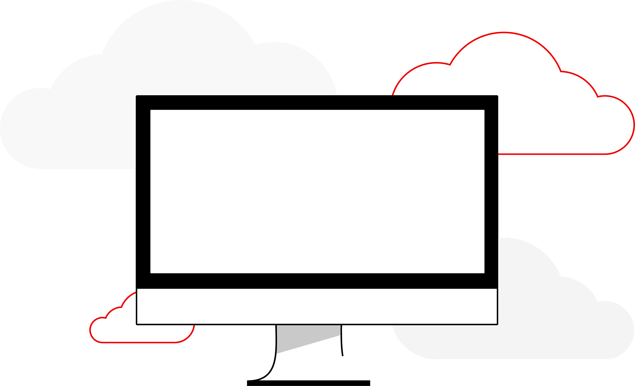

Red Hat Ansible Platform technical deck: Create
Ansible plays
What am I automating?
---
- name: install and start apache
hosts: web
become: yes
What are they?
Top level specification for a group of tasks. Will tell that play which hosts it will execute on and control behavior such as fact gathering or privilege level.
Building blocks for playbooks
Multiple plays can exist within an Ansible playbook that execute on different hosts.
Notes:
A playbook is composed of one or more ‘plays’ in an ordered list. The terms ‘playbook’ and ‘play’ are sports analogies. Each play executes part of the overall goal of the playbook. The play usually defines which machines are affected by the keyword “hosts”. Also connection details are defined, here that the connection should use a privilege escalation via “become”. In the beginning it is not uncommon that a playbook only has one play.
Each play runs one or more tasks. Each task calls an Ansible module.
Ending question: What are the modules?

Slide 18
Red Hat Ansible Platform technical deck: Create
Ansible modules
The “tools in the toolkit”
- name: latest index.html file ...
template:
src: files/index.html
dest: /var/www/html/
What are they?
Parametrized components with internal logic, representing a single step to be done. The modules “do” things in Ansible.
Language
Usually Python, or Powershell for Windows setups. But can be of any language.
Notes:
What are modules? What they are made of?
They are parametrized components with internal logic, representing a single step to be done. The modules “do” things in Ansible.
Usually they are written in Python, or Powershell for Windows setups. But they can be of any language.
Value: Flexibility, just like lego building blocks, to write the automation step by step they need.
Example: If the need to automate certain tasks in VMWare, they just check out the modules they need, write them underneath, add the parameters, and are done.
Ending question: but are modules all that we have? Are there any other ways in which we can change the automation?

Slide 19
Red Hat Ansible Platform technical deck: Create
Ansible plugins
The “extra bits”
Example become plugin:
---
- name: install and start apache
hosts: web
become: yes
Example filter plugins:
{{ some_variable | to_nice_json }}
{{ some_variable | to_nice_yaml }}
What are they?
Plugins are pieces of code that augment
Ansible’s core functionality. Ansible uses a plugin architecture to enable a rich, flexible, and expandable feature set.
Notes:
There are plugins. Plugins are pieces of code that augment Ansible’s core functionality. Ansible uses a plugin architecture to enable a rich, flexible and expandable feature set. Ansible ships with a number of handy plugins, and you can easily write your own. Filter plugins are a good example of plugins. They can transform or format whatever was piped into the filter
Value: Extending the automation, providing interfaces to bring in additional or custom functions.
Example: If there is a custom authorization system on place, a become plugin might help to implement support for that in Ansible.
Ending question: But how do we avoid that every new user of Ansible starts to write a new playbook for something we already solved? If each team has an Apache server, how do we avoid that they all write “their” playbook to automate Apache?

Slide 20
Red Hat Ansible Platform technical deck: Create
Ansible roles
Reusable automation actions
---
- name: install and start apache
hosts: web
roles:
- common
- webservers
What are they?
Group your tasks and variables of your automation in a reusable structure. Write roles once, and share them with others who have similar challenges in front of them.
Notes:
Ansible roles allow creators to write their direct automation commands - sets of tasks, and also variables - in a reusable way. These can be shared with coworkers, with one team, or across an entire company to ease the adoption of automation, and also to define “official” (or “opinionated”) ways to automate certain components.
Value: Create shareable and reusable automation content. Don’t reinvent the wheel each and every time.
Example: There can be a role to properly set up and configure the PostgreSQL DB server. And a role to configure basic security means on all servers. And a role to properly configure all webservers.
Ending question: But where do roles, modules and plugins come from? How can we version this?

Slide 21






Red Hat Ansible Platform technical deck: Create
Collections
Simplified and consistent content delivery
What are they?
Collections are a data structure containing automation content:
Modules
Playbooks
Roles
Plugins
Docs
Tests
Notes:
Meet collections: a way to deliver content.
Can contain all kinds of automation content - most common are modules and “roles”, opinionated sets of playbooks to provide interfaces for typical use cases.
They are versioned, enable collaboration in development of content, can be easily distributed and also lower the barriers to automate existing solutions or products by providing pre-baked content.
Value: Collections can be used by partners, projects and also internal teams to write their content.
Example: F5 releases a new router firmware. They will update the modules of their collections so that those can work with the new firmware. Another example: IBM Qradar ships a new set of features which enables a new, multi step use case. The collection is updated with a role that enables to call the use case with only a few parameters.
Ending question: How does this look in real live?

Slide 22

Red Hat Ansible Platform technical deck: Create
Collections
deploy-nginx.yml
nginx_core
├── MANIFEST.json
├── playbooks
│ ├── deploy-nginx.yml
│ └── ...
├── plugins
├── README.md
└── roles
├── nginx
│ ├── defaults
│ ├── files
│ │ └── …
│ ├── tasks
│ └── templates
│ └── ...
├── nginx_app_protect
└── nginx_config
---
- name: Install NGINX Plus
hosts: all
tasks:
- name: Install NGINX
include_role:
name: nginxinc.nginx
vars:
nginx_type: plus
- name: Install NGINX App Protect
include_role:
name: nginxinc.nginx_app_protect
vars:
nginx_app_protect_setup_license: false
nginx_app_protect_remove_license: false
nginx_app_protect_install_signatures: false
Notes:
What are collections made of? Here we can see a directory layout for a collection, and that a playbook inside a collection is just one part.
Note that the collections keyword - like nginx_core here - is above all a ‘search path’: so that Ansible knows where to look for certain plugins, modules, etc, like the role “nginxinc.nginx_app_protect” in this example.
Value: Packaging, distributing and consuming the content is easy. Clear versioning and independent release cycles enable development of new content at the pace of the owners, not the overall community.
Example: Imagine you have a collection for your nginx core configuration. Using this collection, folks can simply reuse the main nginx stack in a secure, corporate-aligned way without thinking twice about how to do it themselves from scratch (let alone correctly).
Ending question: But where do we store, or get collections from?

Slide 23

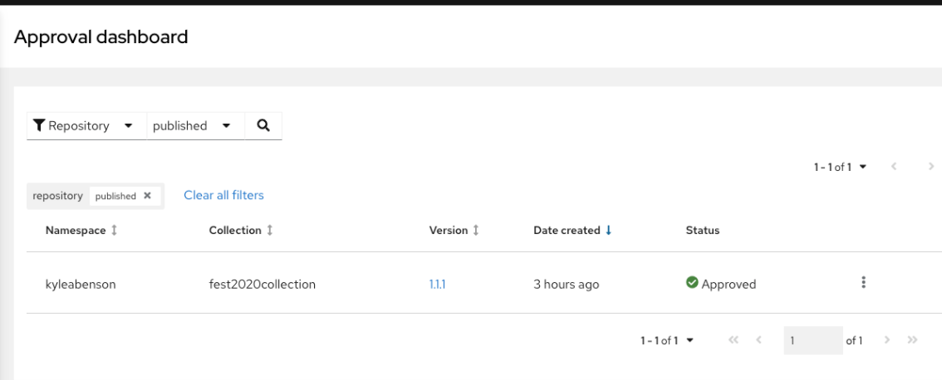
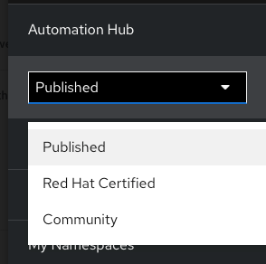
Red Hat Ansible Platform technical deck: Create
Automation Hub
Trusted source
Customer controlled
Deploying either on-prem or to a cloud, customers can run their own private instances of Automation Hub integrated into Red Hat Ansible Automation Platform.
Private content
Manage the lifecycle and internal distribution of in-house Ansible content within Private Automation hub.
Customizable Content Catalog
Via synch from community (Galaxy) and supported (Automation Hub) sources, customers can supply internal users with approved content in one controlled location in Private Automation hub.
Notes:
Where do collections come from? From a trusted source, the Automation Hub! The Automation Hub is a Red Hat hosted service that provides all certified collections from partners and Red Hat alike. And with the help of a on-prem component called Private Automation hub you can also host and manage the internal hosting and distribution of content. Additionally, community content (non-certified) is stored in Ansible Galaxy, an upstream source, and that can also be synced into Private Automation hub if desired.
Value: Central place with all automation code. Secure, maintained “view” for everyone else in the company.
Example: The aforementioned Java middleware deployment collection, together with all supported collections for toolsets internally used, and one or two tested and proven community ones. Others can utilize this and without worry. No need to copy&paste&worry after copying stuff over from stackoverflow.
Ending question: So how does the workflow around content consumption looks like, in an abstract way?

Slide 24




Red Hat Ansible Platform technical deck: Create
Private Automation Hub architecture
Value of Private Automation Hub
Developer IDE
Custom
enterprise content
Automation Hub
cloud.redhat.com
Content SDK
Ansible Galaxy
Private Automation Hub
Red Hat Ansible Automation Platform cluster
Build
Publish
Deliver
Notes:
Content is provided on the left, either privately for example hosted on your Github repository, or from Red Hat and partners via Automation Hub, or via the community repository Ansible Galaxy.
This is imported into Private Automation Hub, and provided from there towards different components of the platform like Automation controller: there the content itself is accessed and downloaded, and Automation controller uses it to automate the target systems on the right.
value: clear workflow, enabling CI/CD pipelines and versioned views of content
example: Private Automation Hub can store multiple versions of the Check Point collection, for the different Check Point versions used in house.
Next question: How do the components like Automation controller actually pull the collections code, in technical terms? How does it really work?

Slide 25



Accessing collections
Red Hat Ansible Platform technical deck: Create
How to get them
Requirements file
Pull via controller
Command line
Requirements file defines the required collections for a playbook
Automation controller pulls the collections from Automation Hub automatically
CLI access is also possible via ansible-galaxy command
Notes:
Collections are brought into the entire structure via three ways: Requirements files next to your playbooks describe what collections should be present for the automation-content at hand. Automation controller can read those, or searches to Private Automation hub automatically for needed collections and pull them automatically.
There is also a CLI for downloading collections. We will look at the specifics of Automation controller and the CLI later.
Value: Consuming collections is done automatically in the background, there is no need to track or worry where they are and how uploaded what when where.
Example: Collection is added for mycorp frontend: it can be automatically consumed via the configured paths.
Ending question: This is great! But what is if there is a new version of a collection? Or of Ansible? Or one of the dependencies? How do I keep certain versions of the stack here and other versions of the stack there? How do I test the stack?

Slide 26





Many technologies, different life cycles
Red Hat Ansible Platform technical deck: Create
How to keep runtime environment, collections and dependencies aligned?
Dependencies
Collections
Runtime
Notes:
This is a real concern, especially when the adoption of the automation grows in size and over time: the collections develop, and new versions might be released which are needed by one team for the new feature A, but not wanted by the other team because of a change in feature B. Also, some collections come with dependencies, for example to cloud SDKs, and those have versions and development as well. Last but not least Ansible itself is developing over time, and some teams want to follow the releases very closely, while others take a more conservative approach.
There is a need to get this all together in a format which is testable, can be verified, and also shared between developers and operations.
Ending question: How do we keep the components together in certain versions? So that it works just the same way on the developers environment as it does on the operators environment?

Slide 27
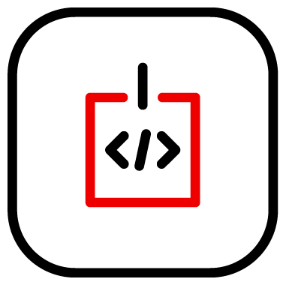
Automation Execution Environments
Red Hat Ansible Platform technical deck: Create
Components needed for automation, packaged in a cloud-native way
Collections
Libraries
Ansible Core
Execution
Environments
Universal Base Image
Notes:
The components can be kept together in a typical way most of people are familiar with today: a standardized container! Meet the Automation execution environments: containers that only package the components needed for automation, packaged in a cloud-native way.
Value: Standardized, cloud native package containing all the components of the automation, including the dependencies and the core Ansible version. This all based on the tested and trusted RHEL Universal Base Image.
Example: AWS EE, containing the aws collection, the necessary AWS Python libraries and the Ansible version the team has already tested.
Ending question: Now we have the format to package and ship it in ways most people are familiar with. How do we actually built those?

Slide 28



Red Hat Ansible Platform technical deck: Create
Build, create, publish
Development cycle of an automation execution environment
Collections
UBI
Dependencies
Content
Creator
Execution environment builder
Private automation hub
Ansible Core
Execution
Environment
Notes:
Building EEs is rather simple: we provide the tool execution environment builder, the CLI tool ansible-builder for this, which knows how to bring the pieces together in just the right way and create the EE. They can be published on Private Automation hub or in any container registry.
Value: Clear and simple tooling to let the creators focus on what they are best at: the automation content.
Example: The creators take the Check Point collection and dependencies and Ansible version, and just run ansible-builder. They don’t have to worry about Dockerfiles.
Ending question: And how do we run automation content with EEs? ansible-playbook was never written with containers in mind!

Slide 29


Red Hat Ansible Platform technical deck: Create
Develop, test, run
How to develop, test and run containerized Ansible content
Scalable
Content
Creator
Automation content navigator
Playbook
Execution
Environments
Supported
Notes:
How do you execute automation content when there are EEs in the background? Automation content navigator gives developers and creators a command-line tool to execute EEs on their development machines. Automation content navigator is discrete a Python application called ansible-navigator bundled with Ansible Automation Platform.
Challenge: Containerized execution introduces new challenges for developing, testing, and deploying Ansible content destined for Automation Controller*.
Value: Provides a more cohesive, more consistent, predictable, top-level developer experience for content destined to be run on the Platform. Leverages existing CLI knowledge while introducing enhancements due to containerized execution.
Example: The creator wrote a IBM cloud EE, and wants to quickly test it. ansible-navigator is the right tool.
Ending question: Now we discussed how to write all this automation content. But how do we run it, apart from developing and testing? Where is the enterprise scale?

Slide 30

Red Hat Ansible Platform technical deck
Operate
Notes:
After all, the automation content is nothing without executing it, running it against nodes of your choice.

Slide 31
Red Hat Ansible Platform technical deck: Operate
Operate
The automation lifecycle
Automation hub
On-premises
Ansible Cloud Services
Insights for Ansible Automation Platform
Control
Operators
Automation controller
Manage
Ansible command line
Deploy
Notes:
Executing automation is what operators usually worry about: how do we operate all this automation? Where is what executed how? How do we track it all? After all, what we need is not mindless monitoring, but actual observability.
So let’s assume we are an operator in mycorp, a person running all the bits and pieces, who needs to make it happen, but also needs to understand what is happening, and where. Let’s look at the bits and pieces.

Slide 32
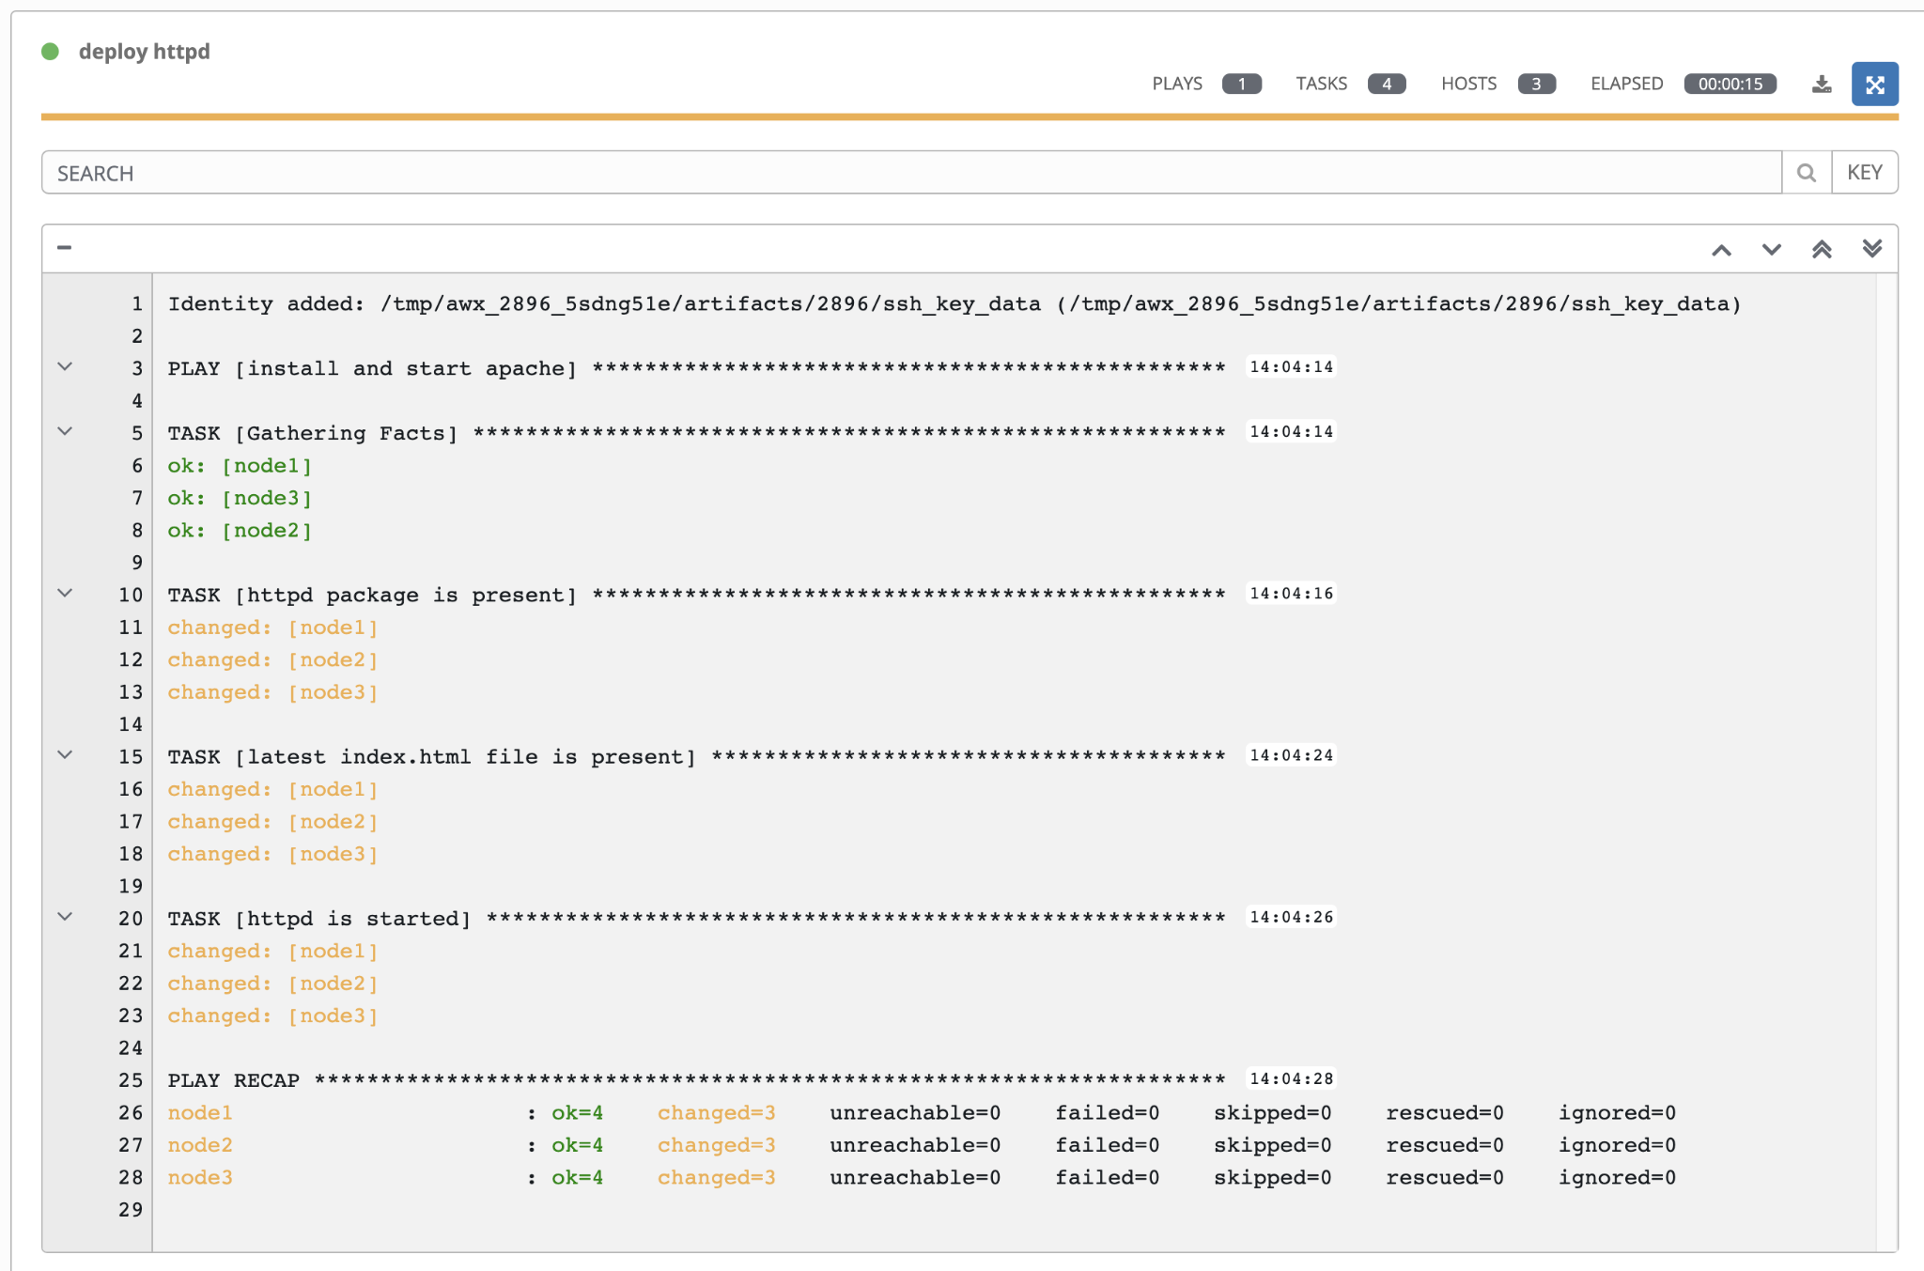
Red Hat Ansible Platform technical deck: Operate
A playbook run
Where it all starts
A playbook is interpreted and run against one or multiple hosts - task by task. The order of the tasks defines the execution.
In each task, the module does the actual work.
Notes:
We start by executing the playbook from above, and run it against two hosts.
Playbook is interpreted, task by task (ordered execution).
In each task, a module does the actual work (as mentioned). Variables can be important here as well.
Each task has a name, which is the name field from each task in the playbook being run. This has the added advantage of understanding what is expected of each task.
Value: Clear and simple to follow execution pattern, easy to understand even with limited developer background
Example: A playbook to automate windows environments, first adding users to AD, ensuring policies, and then provisioning server nodes for these users to use in development.
Ending question: But where does the execution takes place in “real” setups? How to do we trigger, watch, monitor this execution?

Slide 33
Red Hat Ansible Platform technical deck: Operate
Components of Automation
Playbooks
Execution Environments
Notes:
As a reminder, the core components of an automation are the playbooks telling what to do during the automation, and the Automation execution environments brining along all the content needed for this.
But executing this content on an enterprise level requires more, higher level components.

Slide 34
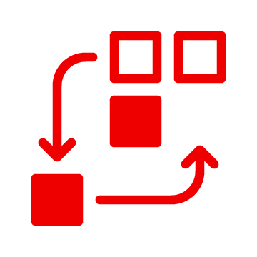

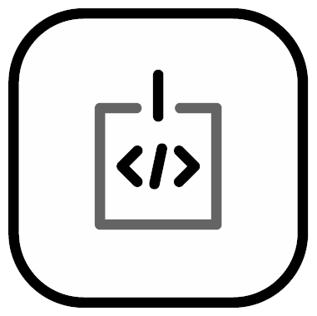
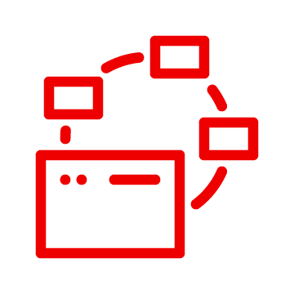

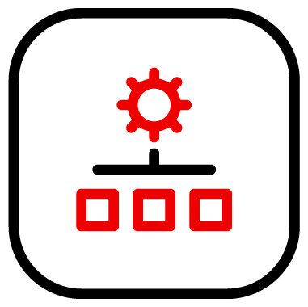
Red Hat Ansible Platform technical deck: Operate
Anatomy of Automation Operation
Workflows
Credentials
Centralized Logging & Audit Trail
API & Webhooks
Automation controller
Notes:
At scale, meaning with multiple people or teams involved, in a business and enterprise environment, there is a need for more secure operations, with a deeper understanding of what is happening. Also, automation is no longer about single use cases, but about end-to-end automation, chaining together multiple automation pieces into larger more complex workflows.
Integration with the surrounding is also crucial: the automation needs to be a part of the overall IT ecosystem, and the communication can go both ways: systems are integrated with each other, orchestrated by Ansible. But there are also environments which reach out to the API of Ansible to integrate the automation in their processes - ITSM systems are a good example.
This is provided with the automation controller, the central on-premises installed component of the Ansible Automation Platform. And where automation scales, Automation controller is extended by the hosted services governing it and providing insight into the cluster - or multiple.
Let’s have a detailed look.

Slide 35
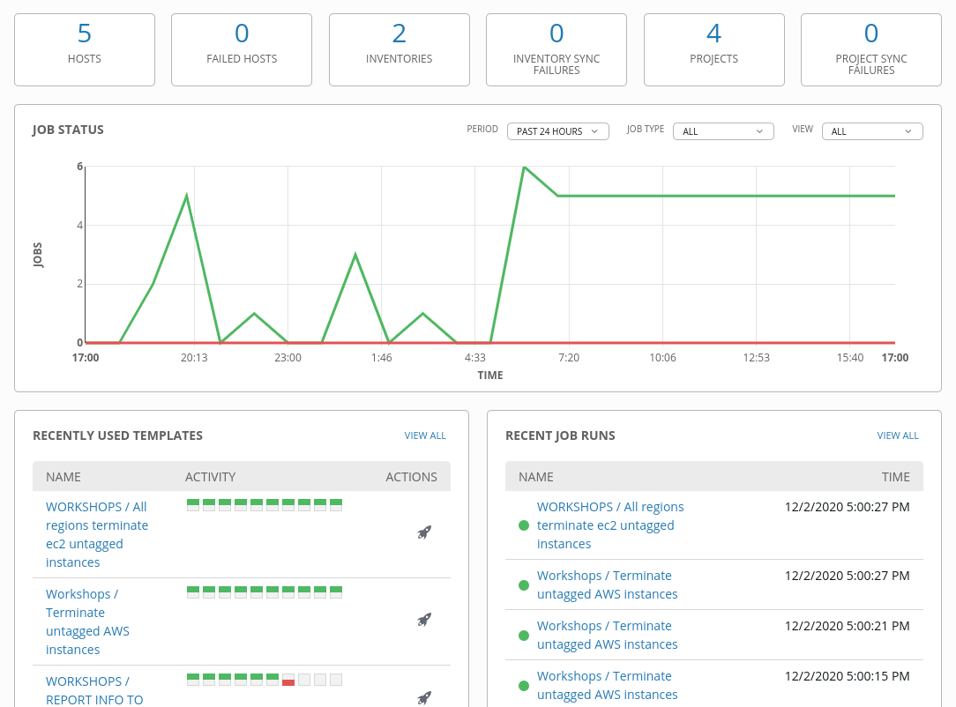
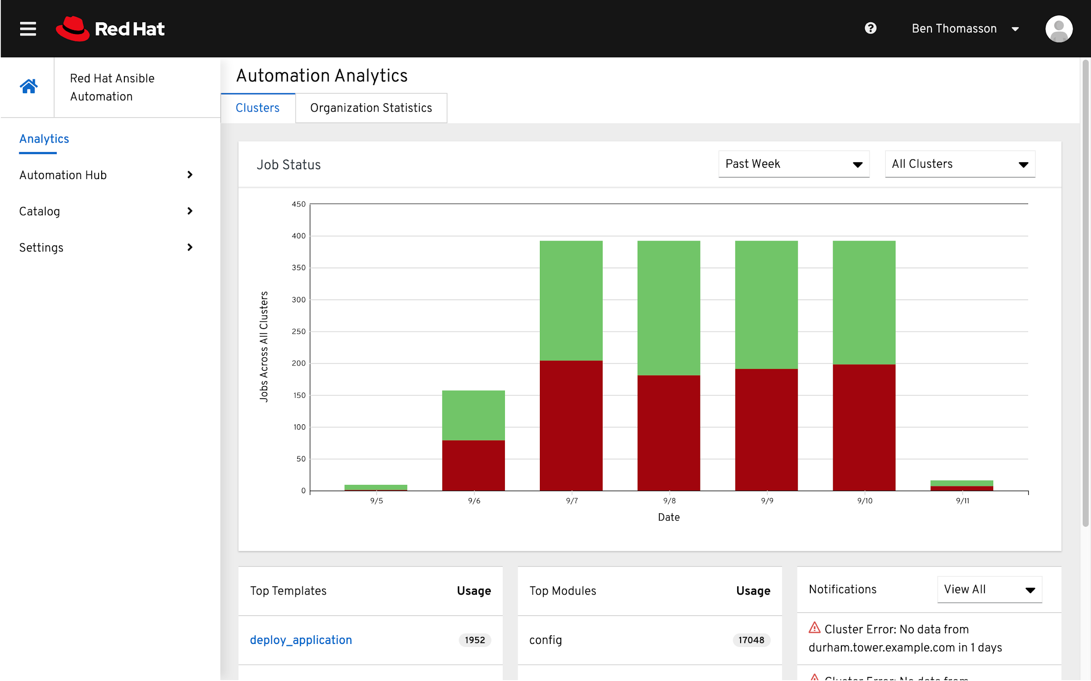
Red Hat Ansible Platform technical deck: Operate
Dashboards
Understand what is going on
Overview of the actual cluster, the jobs happening, the nodes connected, what works and fails right at this moment.
Overview across clusters, better insight into use cases of automation; insight into adoption of automation per organization.
Notes:
Observability of automation - dashboard, analytics. More than just monitoring and collecting and forwarding logs: it provides valuable understanding of what is actually happening from the perspective of the automation operator.
Value: Quick overview of operational state, deep insight into the adoption and usage of automation
Example: The ops team lead wants to check if the automation is currently running without trouble, and cheks the dashboard for current state and problems. The IT manager however needs to identify what the automation overall is doing, which organizations are using it, what use cases are automated and what not, and uses analytics to get more insight into this.
Ending question: Speaking about visuals and dashboards. Is there a shopping card experience somewhere? How can I expose my automation to people who are not Ansible people or maybe not even really IT people?

Slide 36
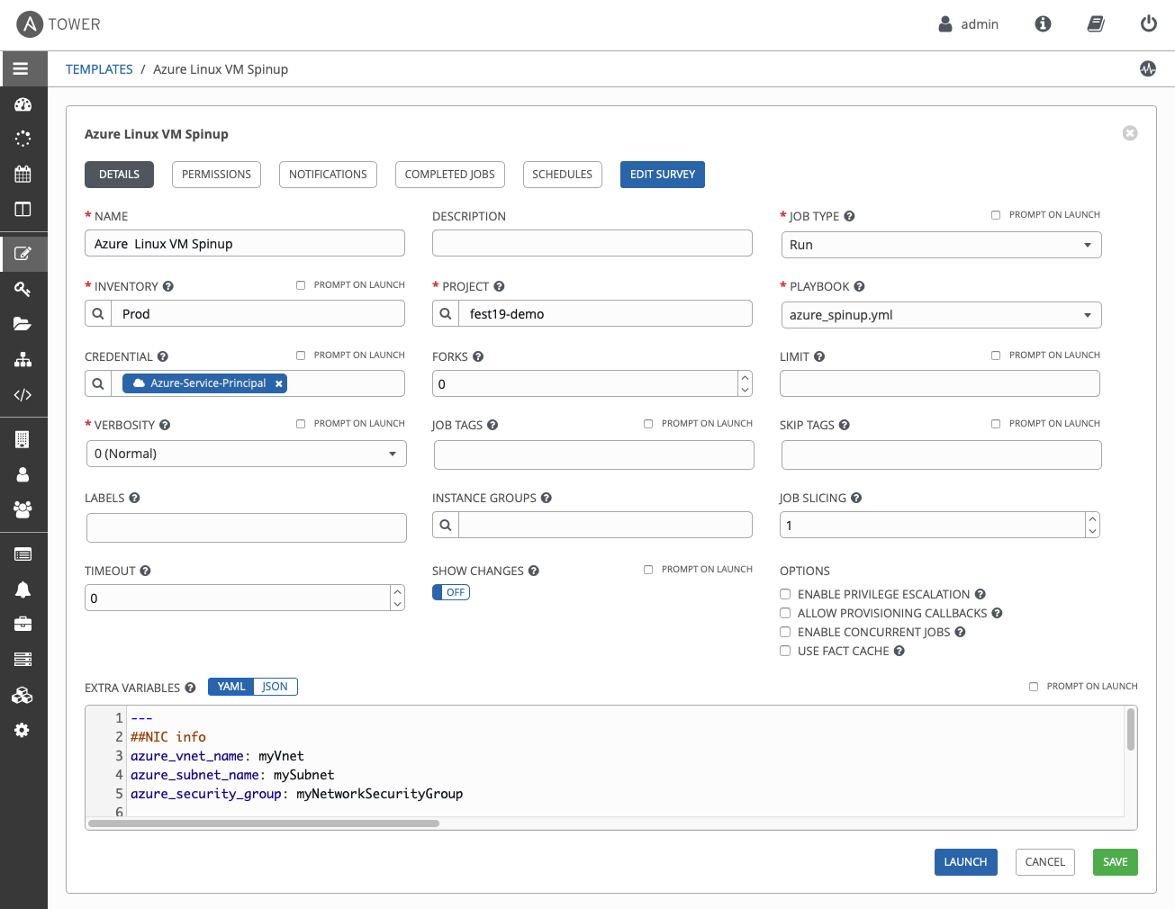
Red Hat Ansible Platform technical deck: Operate
Execution of content
Running at the core
The central execution of automation content is managed and done either via central cluster..
Can also sync git repositories, takes care of execution environments, collections, credentials, inventory and logging.
Full audit trail of the execution, including what version of content was executed, what variable values were provided, etc.
Notes:
Where does all our automation code get executed (at scale)? On Automation controller! A central cluster, or on nodes distributed across the network,governing the automation execution and providing capabilities around it.
Management of “surroundings” like credentials, sync to gits, etc., is taken care of, also provides full audit trail of the entire execution
Value: Central execution of code. Teams don’t have to worry who needs to execute what where.
Example: The dev and the ops team run automation code, with different git repos for their playbooks, different credentials, and server nodes spread across multiple data centers. But it is all taken care of transparently via automation cluster.
Ending question: But how do we now which machines are we talking to, exactly? And how can we influence that?

Slide 37
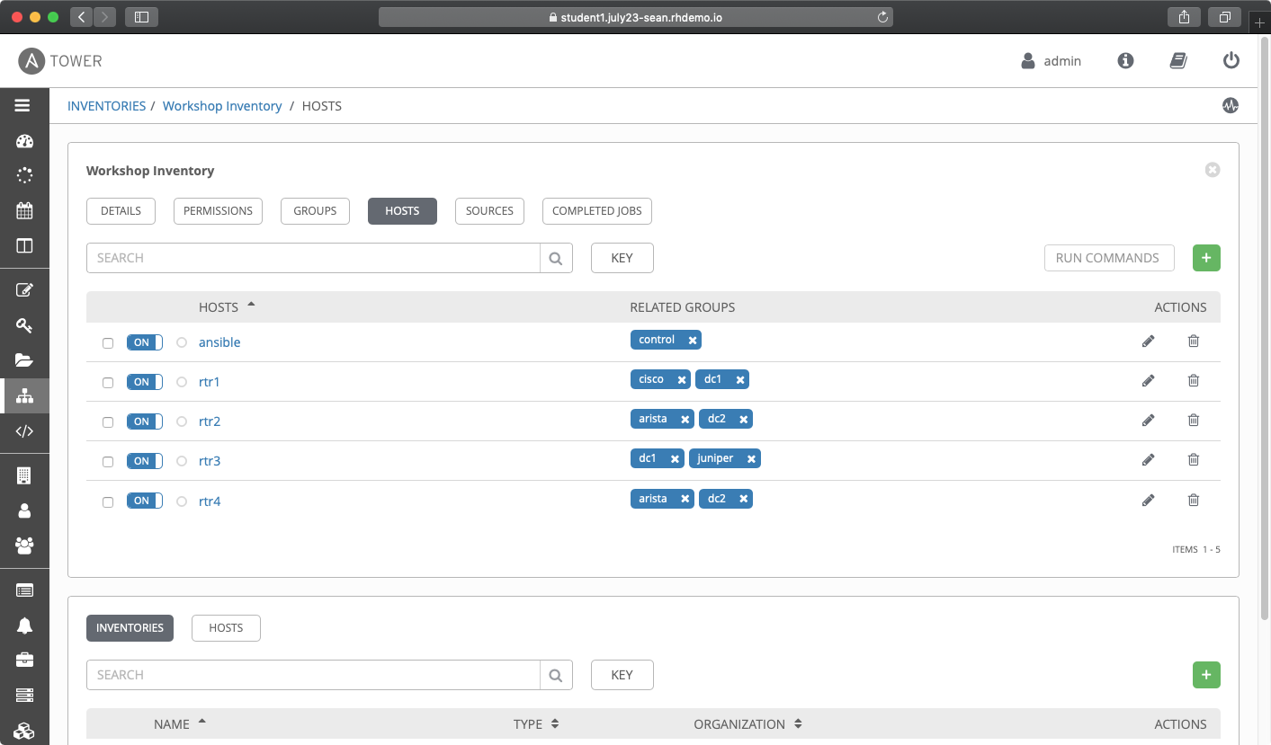
Red Hat Ansible Platform technical deck: Operate
Inventories and credentials
How to talk to others
An inventory is a collection of hosts (nodes) with associated data and groupings that the automation platform can connect to and manage:
Nodes
Groups
Can be static or dynamic
Smart inventories possible
And what usernames and passwords do you use during connection? That is kept in the credentials.
Notes:
Ansible has the concept of “inventories”: lists of nodes to talk to, which can also be grouped together. Think of simple ini structures here (or yaml or json). The lists can be generated dynamically for example by asking a VSPhere instance or Azure Cloud what machines are currently present, and how they are tagged.
Smart inventories take this approach one level further by enabling us to look at all our existing inventories, and get all machines with certain conditions, like all Windows servers.
Value: Ease of integration into existing infrastructure. No need to replace existing workflows and procedures, Ansible can just use the source of truth that is already there (such as cloud environments, Active Directory, Red Hat Satellite among many others).
Example: The cloud team starts automating with the Ansible platform. Instead of manually collecting the knowledge about all existing VMs and updating that frequently, the information are collected from all cloud accounts. And actions can be executed transparently across them.
Ending question: So we now know how to execute, and what to run against. But what if we have more than one thing to execute? Can we chain those?

Slide 38
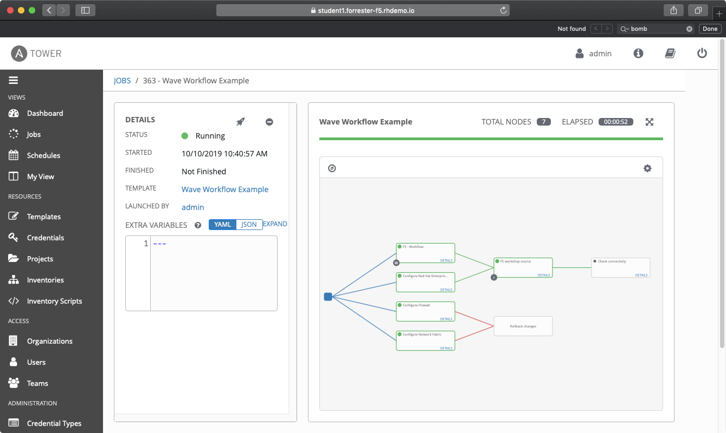
Red Hat Ansible Platform technical deck: Operate
Workflows
Combine automation to create something bigger
Workflows enable the creation of powerful holistic automation, chaining together multiple pieces of automation and events.
Simple logic inside these workflows can trigger automation depending on the success or failure of previous steps.
Notes:
Workflows allow users to chain together disparate jobs in Automation controller together. They are linked together using a graph-like structure that can be modified in a visual editor. This provides a holistic overview of the automation and enables to stitch together automation code from different teams, including the ability to fork tasks to run simultaneously and logic for handling successful and failed outcomes.
Value: Orchestration across multiple automation jobs, even from different teams.
Example: The storage, the networking team and the ops team all have their own automation code in their own repositories. To bring all their code for a complex deployment together, the deployment is layed out via a workflow, enabling to start the complex process across multiple teams with one click.
Ending question: So we now how to execute automation, even across teams. But how do we integrate it with other tools? With the monitoring for example?

Slide 39
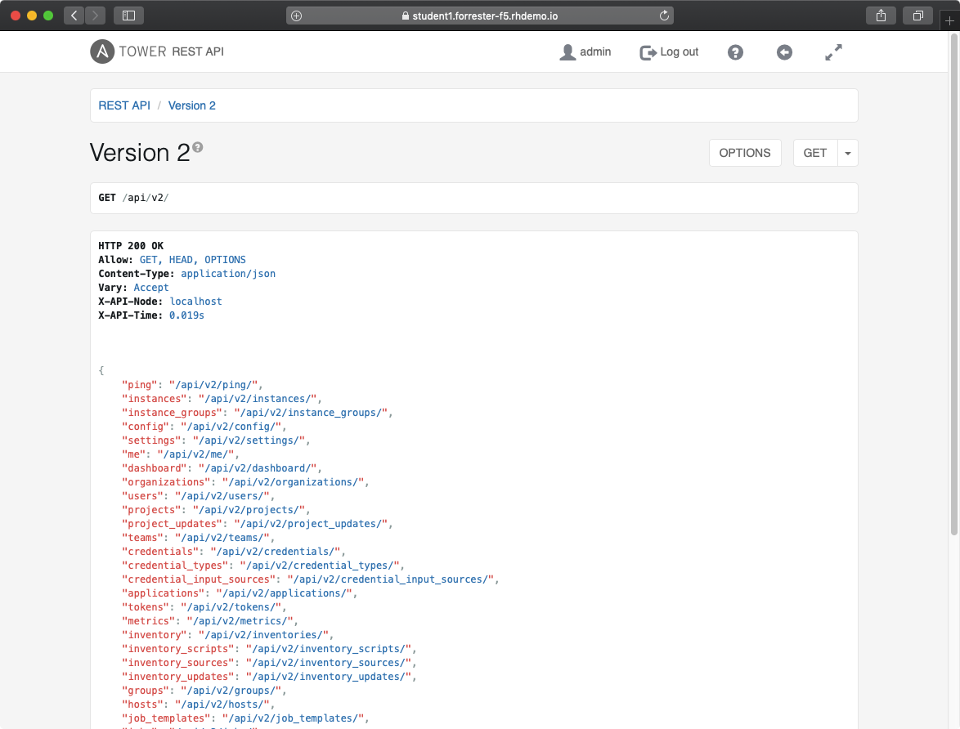
Red Hat Ansible Platform technical deck: Operate
API
Integration of automation into larger workflows
The API provides programmatic access to the automation via a defined interface.
Underneath it is still powered by the same bits and pieces which are at the core: workflows, inventories, etc.
It offers simple integration into other tools like ITSM, SOAR, etc.
Notes:
The API offers programmatic, feature-complete access to the automation of the platform. This enables seamless integration into other tools like monitoring, but also like other orchestration tools like a SOAR or a CI/CD pipeline/build system.
Value: Neatly integrate the automation into existing environments and processes. Use what is there and glue it together instead of throw everything away and built it from the ground up.
Example: The internal IT support uses a well established SalesForce for ITSM tasks. The processes are known to everyone, but in the back require a lot of manual work and self-written, hard to maintain scripts. With the help of the API of the automation platform the self written scripts and the manual work can be replaced by streamlined automation and “attached” to the ITSM without the need to change anything towards the user perspective
Ending question: Now we have it all - how do we keep an overview of all this?

Slide 40

Red Hat Ansible Platform technical deck
Consume
Notes:
Consuming automation is all about how to provide your automation content to others.
This might be people who are not that technical at all - but also people from other IT domains. After all, automation in enterprises is a lot about bringing teams together.

Slide 41
Red Hat Ansible Platform technical deck: Consume
Consume
The automation lifecycle
Automation controller
Automation services catalog
Execute
Users
Automation hub
Ansible command line
Integrate
Ansible Content Domains
Ansible content domains
Adopt
Infrastructure
Cloud
Network
Security
Domain experts
Linux
Windows
Notes:
Automation is nothing without people using it, mapping it to their workflows, and using it to make it shift and move things in their daily work.
Let’s assume we are a user of automation in mycorp, a person who needs stuff to be done and want that to happen automatically, and have a look at how we consume automation from the Platform.

Slide 42


Red Hat Ansible Platform technical deck: Consume
Self service
Automation job
Approval
Web UI
Control plane
Users
API
Role based access control
Users
Execution Plane
Execution environments
Users
Notes:
How do the bits related to each other, and how does the communication flow works?
In this image we see the overall architecture of the different components and how they work with each other, from a consumer perspective. The consumer on the left side accesses the interface of their choice - web UI or API - and triggers pre-created automation content via a self-service portal. This process is governed by enterprise RBAC support, and approval processes make sure that no one requests more automation than they should be granted.
In the end, the execution of the content will be triggered, and that will automate the pieces the user needs to be.

Slide 43
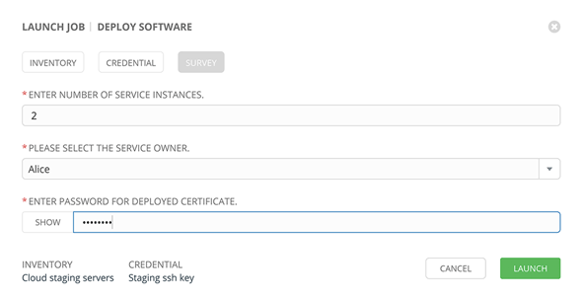
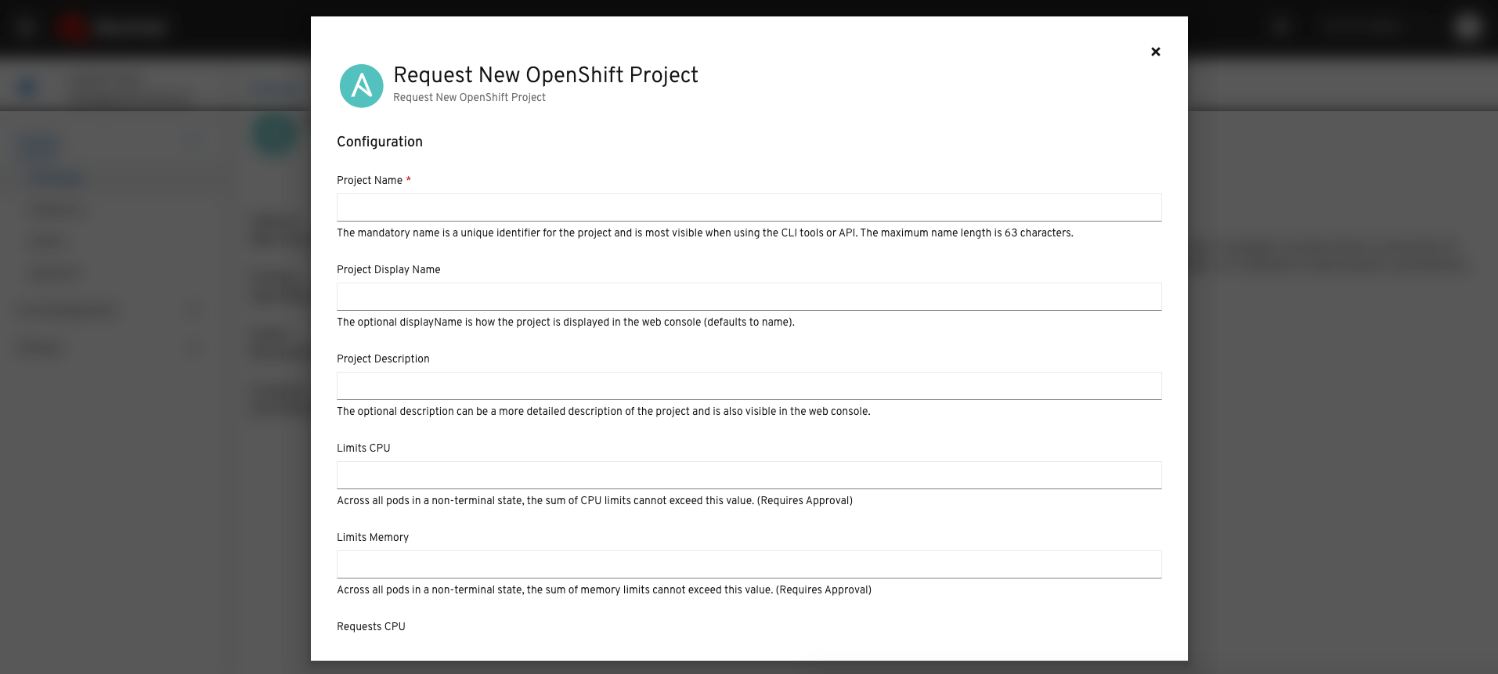

Red Hat Ansible Platform technical deck: Consume
Self service
Provide others the mean to consume
For teams directly accessing the automation environment and are close to the automation platform processes.
For high level access distant or not even aware of the underlying automation environment; lines of business for example.
Notes:
One of the core pieces consumers will be using are the self service capabilities which enable to consume pre-created automation content provided by others. The inherent strength in offering this form of automation consumption is in reducing the required direct communication between myriads of consumers and a limited set of developers. In fact, the people who pre-created the automation content don’t even have to know who (specifically) is using their content.
One thing to note here: The credentials used in the automation content are not exposed to the consumers! So people who write automation content can even include necessary credentials, without the fear of losing control of it.
Shown here are two ways to access self service: via the on-premise installed Automation controller, and via the Red Hat hosted Service Catalog, both serving different use cases.
Value: Providing pre-defined automation to others to consume when and how they need it.
Example: The ops team provides two automation workflows to the dev team as self service: to spin up and tear down an entire development environment. The dev team can use it when they need it, without any need to consult with the ops team.
Ending question: But can everyone access everything? Or are there ways to limit access here?

Slide 44
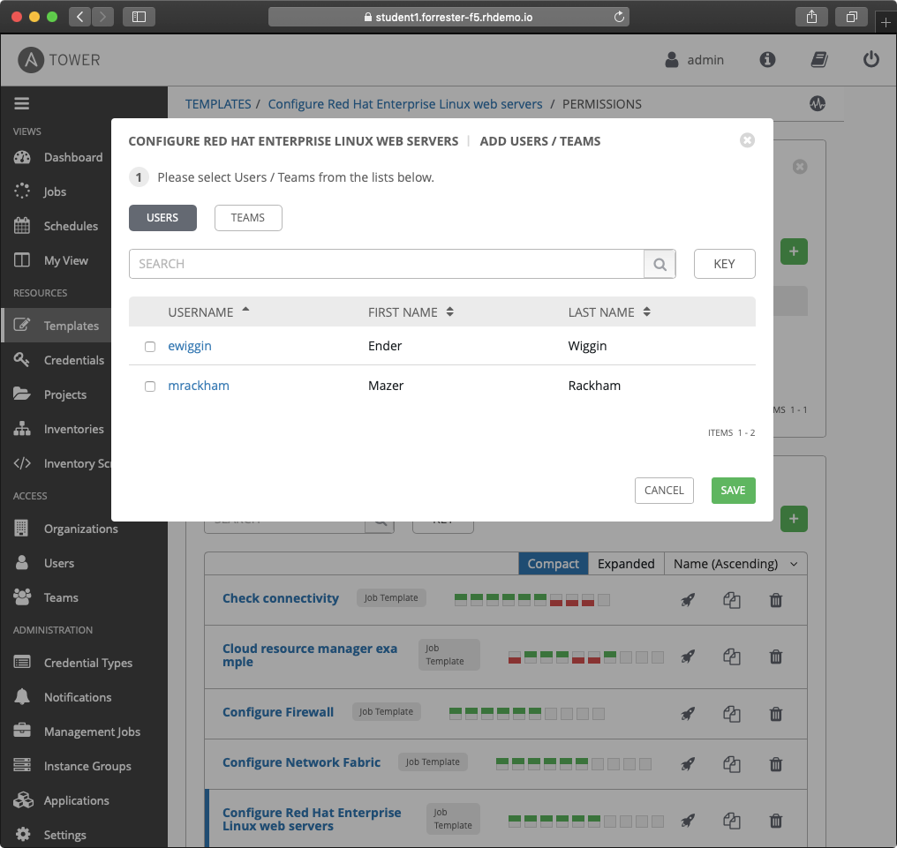
Red Hat Ansible Platform technical deck: Consume
Role-based access control
How to manage access
Role-based access control system: Users can be grouped in teams, and roles can be assigned to the teams.
Rights to edit or use can be assigned across all objects.
All backed by enterprise authentication if needed.
Notes:
Access to the automation content can be limited to only what a consumer needs. The Automation controller UI offers role based access control: people can be grouped in teams, and roles can be assigned to these groups. Permissions can be granted or denied to almost all objects, such as jobs and credentials
Additionally, a predefined ‘Auditor’ role is available who can see all aspects of the systems automation, but has no permission to run or change automation, for those that need a system-level auditor.
This all is backed by enterprise authentication: the Automation controller authentication can be connected to AD and other enterprise tools, the groups and roles can be mapped accordingly.
Value: Proper roles system eases governance of access and execution
Example: Security team onboards a new team member. That one is added to the security team group in AD, and thus automatically inherits the same rights as the others. Part of these rights is to see and execute, but not change the automation jobs from the IT OPS teams.
Ending question: Glad to hear that the access can be limited. But what about governance? How can I control how many resources someone accesses? After all, automation is great, but it should not get out of hand!

Slide 45
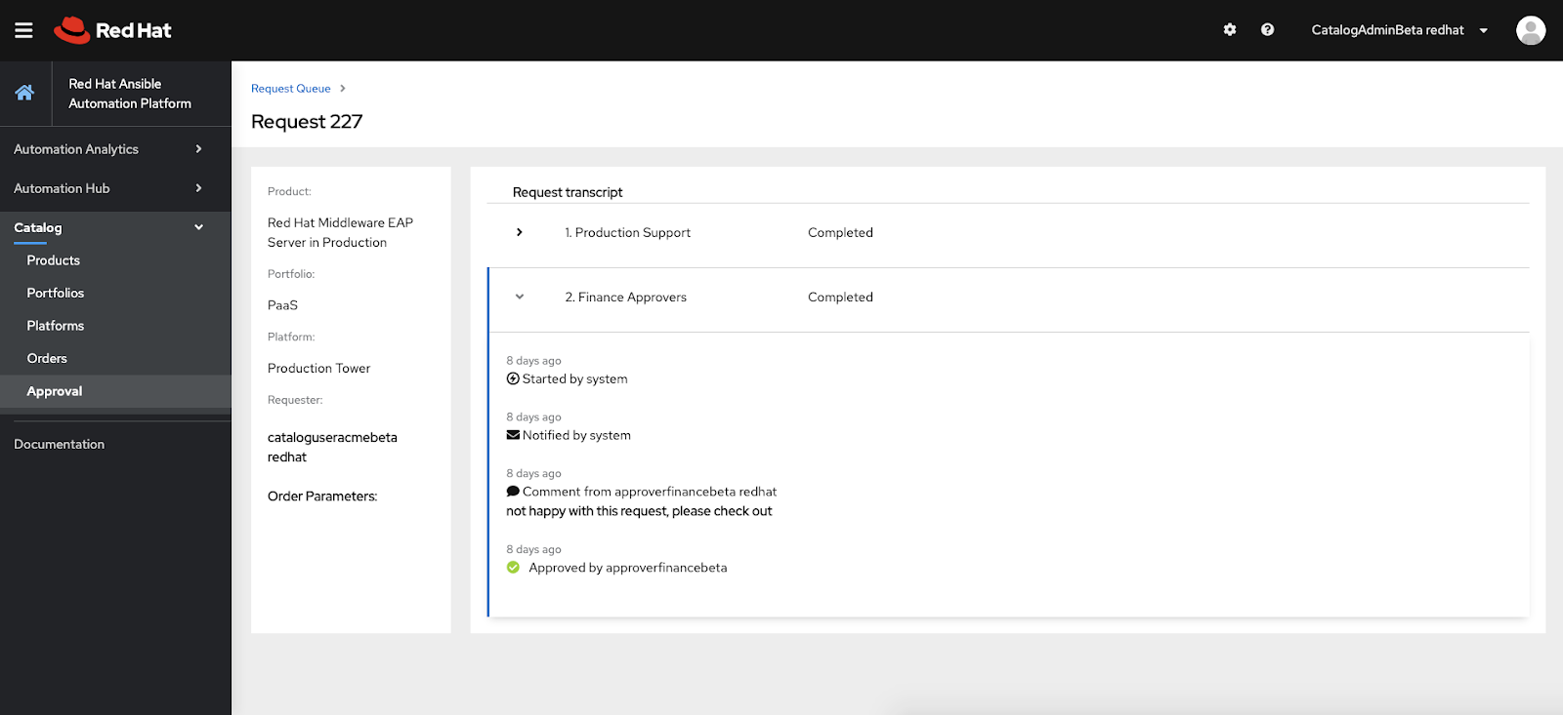
Red Hat Ansible Platform technical deck: Consume
Approval
Govern access
Approval processes allow a human interaction to the automation, to add governance like human level administration.
Both available at the operational level on the Automation controller UI as well as in the service catalog level.
Notes:
Approval processes can put safeguards in place (requiring human approval) when such governance is required.
It is available at both levels: within the Automation controller UI, as well as in the service catalog.
Value: Approval processes add a human interaction into the self service part of automation to ensure governance and enable approvers to stop usage which is not aligned with current tasks or business goals.
Example: The networking team offers their automation via self service to let consumers create (and configure) dedicated subnets when needed across all networking devices. But to ensure that not too many subnets are created, an approval process is added where the architect team lead needs to approve requests.
Ending question: This is great for our technical level things - but high level processes are already mapped out in our ITSM tool like Salesforce. Can we somehow integrate that with the platform as well?

Slide 46
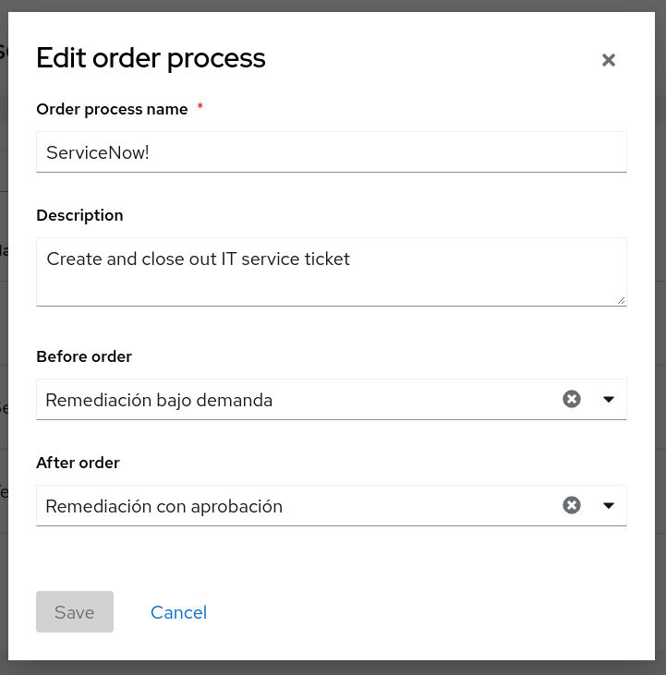
Red Hat Ansible Platform technical deck: Consume
IT service management integration (ITSM)
Incorporate automation into your ITSM
Integrate high level workflows in existing ITSM toolsets with the automation platform.
Have the automation platform reach out to the ITSM system whenever things are changing, including data transmission between the tools.
Notes:
Integration of ITSM enables transparent execution of tasks across the tools.
This way, the automation platform can perform tasks on the ITSM environment before and after services are launched, ensuring that the ITSM is updated on changes transparently.
Value: Tasks triggered in catalog are proactively tracked in the ITSM tool, including necessary data.
Example: Line of business usually uses the catalog shopping card function to order the automation components they need. However,
Ending question: I’m sold. Where can I get started?

Slide 47


Next steps
Where to go next
Learn more
Workshops
Documents
Youtube
Twitter
Get started
Evals
cloud.redhat.com
Get serious
Red Hat Automation Adoption Journey
Red Hat Training
Red Hat Consulting
Notes:
These are the options to get you started!

Slide 48
Thank you
Red Hat is the world’s leading provider of enterprise open source software solutions. Award-winning support, training, and consulting services make
Red Hat a trusted adviser to the Fortune 500.

